Slide 1

Micro-Credit Defaulter Model Presentation
By : ROSHAN KUMAR

Slide 2
Introduction:
A Telecom Industry has tied up with a MFI and is helping the customers avail small loans over the mobile recharges for a limited number of days and want to figure out a way through which they can predict the defaulter and non-defaulter.
As a result they have provided data collected over a period of time and over various customers. That can provide a clear picture of the problem at hand and at same time creating a model that can predict the future of the customers based on information from the current customer base. Some of which are as follows–Frequency of data account recharged.
Maximum amount of loan taken by the user .
Average payback time; and so on.

Slide 3
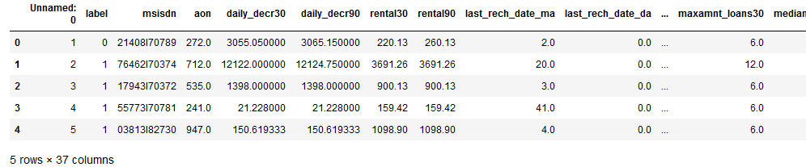
About the Dataset
Data contains 209593 entries each having 37 variables.
Data contains no Null values.
This dataset is a good blend of numerical, categorical and nominal data.

Slide 4





Tools used
pandas
NumPy
seaborn
matplotlib.pyplot
scikit-learn

Slide 5
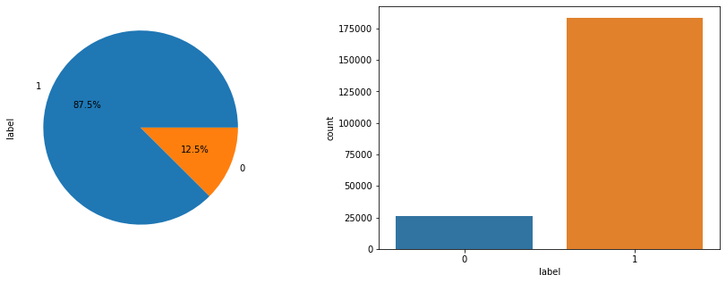
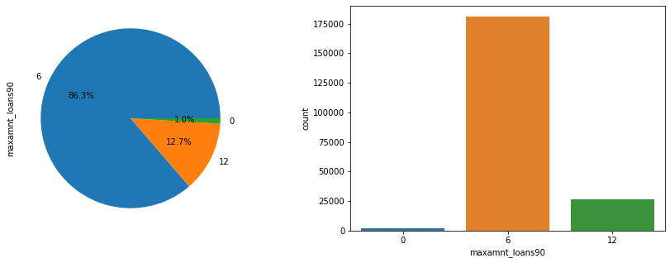
Exploratory Data Analysis:
Label ‘1’ indicates that the loan has been paid i.e. Non- defaulter, while, Label ‘0’ indicates that the loan has not been paid i.e. defaulter.
Maximum amount of loan taken by the user in last 90 days had 3 categories. Where highest count of people had taken the loan for 6 months.

Slide 6
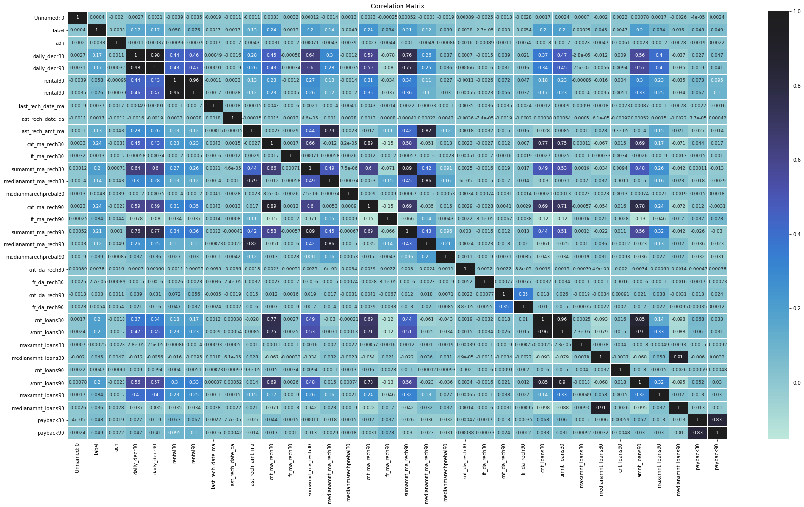
Exploratory Data Analysis:
correlation between daily_decr90 and daily_decr30, rental90 and rental30,sumamnt_ma_rech90 with daily_decr90 and daily_decr30, sumamnt_ma_rech30 correlation between medianamnt_ma_rech90 with last_rech_amt_ma, correlation between cnt_ma_rech30 with cnt_ma_rech90,amnt_loans90 with cnt_ma_rech90 was there.

Slide 7
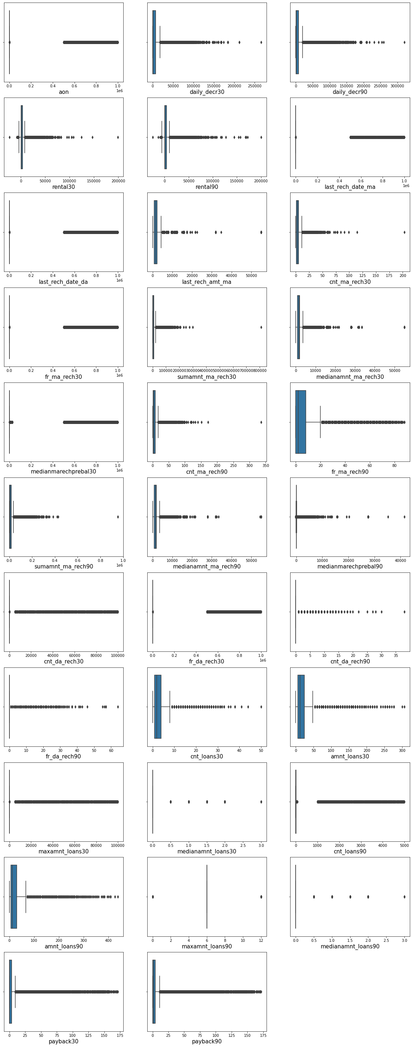
Exploratory Data Analysis:
The dataset had a lot of outliers and missing values which was found by doing exploratory data analysis. It was done by using outlier detection by trying find plotting each data(continuous) through boxplot.

Slide 8
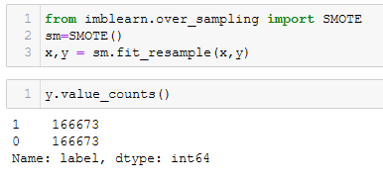
Treating imbalanced target:
As the target variable was imbalanced , we have used SMOTE to balance the data.

Slide 9
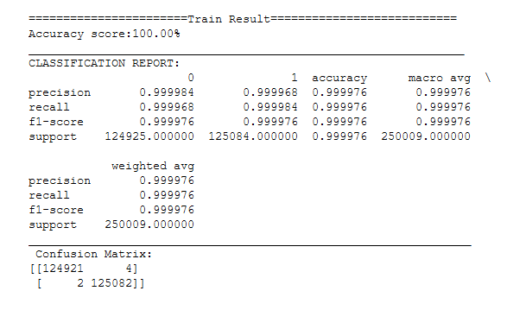
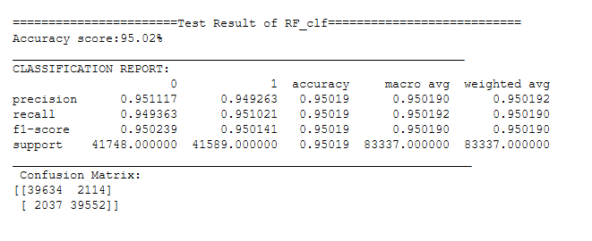
Model Creation and Prediction:
We have made 4 models. Out of which Random Forest Classifier has given the best accuracy of 95%.

Slide 10
Conclusion:
THE DATASET CONTAINED REAL WORLD INFORMATION ABOUT THE BEHAVIOUR OF THE CUSTOMERS. IT ALSO PROVED THAT BEHAVIOUR ID PREDICTABLE.
THIS PROJECT HAS MANY REAL WORLD APPLICATIONS ESPECIALLY IN THE FINANCIAL FIELDS. THE BANKING INDUSTRY IS ALWAYS ON THE LOOKOUT FOR POTENTIAL CUSTOMERS TO GIVE LOAN TO BUT THEY WOULD NOT WANT TO END UP ON A TRADE THAT WOULD RESULT IN LOOSING OUT MONEY.
THE DEBT SITUATION IN AN ECONOMY ALWAYS HELPS TO MOVE THE ECONOMY FORWARD BUT IF THERE ARE A LOT DEFAULTERS THEN IT MIGHT PROVE TO BE A FINANCIAL DISASTER .
SO THIS PROJECTS NOT ONLY PROVIDES INSIGHT INTO THE PATTERN OF HUMAN BEHAVIOUR BUT ALSO PROVIDES A WAY OUT OF A FIANACIAL CRISIS.
BUT THEN AGAIN IF THE BANKS AND THE REST OF FINANCIAL INSTITUTIONS WERE ONLY TO PROVIDE LOANS TO THE PEOPLE WHO CAN PAY BACK THE LOAN AMOUNT THEN WHAT WOULD HAPPEN TO THE PEOPLE WHO ACCORDING TO THE MODLE ARE ‘POTENTIAL DEFAULTERS’. SO THE BANKS AND THE OTHER MICRO FINANCIAL INSTITUTIONS MUST ALSO PROVIDE A WAY OUT FOR THOSE ‘POTENTIAL DEFAULTERS’.

Slide 11


Thank you for your attention!
Contact Information :
Email : roshan.kr.hit@gmail.com

